Slide 1
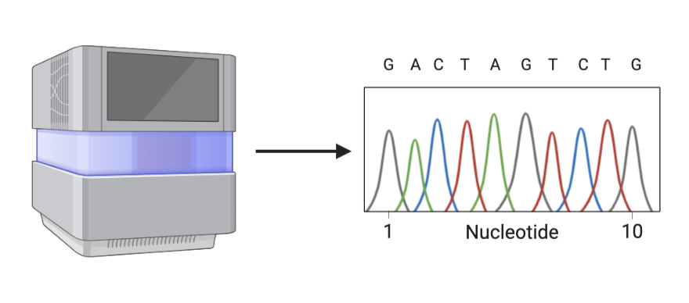
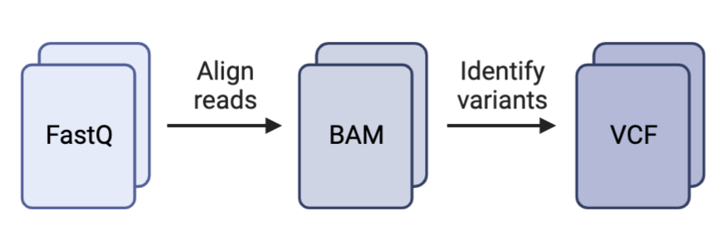
NGS workflow Summary
1
Primary analysis results are stored on Pluto as fastq.gz files.
Raw paired-end reads
Secondary analysis is performed on fastq.gz files.
ASUT_health_HAdV project specific:
Trimming
trim_galore
Local alignment and mapping
bwa mem
Indexing and consensus generation
Samtools
Secondary analysis results are distributed/used for further downstream analysis.
fasta/bam
Variant calling
Phylogeny
Abundance analysis
csv/tsv
Data normalization
Data visualization
Primary Analysis
2
1
Pluto
3
2
Secondary Analysis
3
Project
Project
Project

Slide 2

The Plan: Standard 15

Slide 3
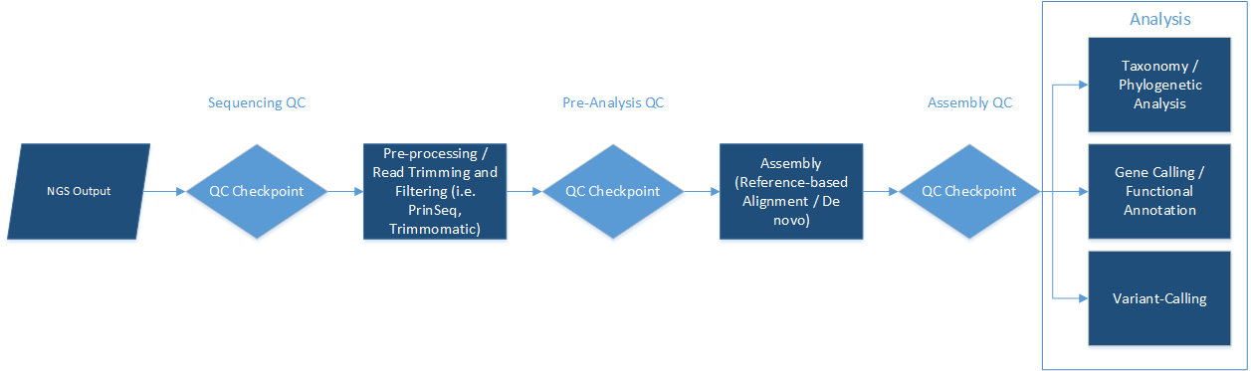
Secondary Analysis Pipeline
The majority of secondary analysis pipeline remains constant.
Variability is intruded during QC Checkpoints. (e.g. Primers, adapters, indexes, reference genomes, tooling parameters)
Variable portions can be treated as “cassettes” to be inserted into the pipeline.
Cassettes can be in the form of input files or python scripts to be read into the pipeline.
Variability: Primers, adapter, indexes, tooling parameters
Variability: Reference genomes, tooling parameters
Variability: Pairwise, de novo, MSA, tooling parameters
Project specific parameters as “Sequencing QC cassette”
Project specific parameters as “Pre-analysis QC cassette”
Project specific parameters as “Assembly QC cassette”
Log output
Log output
Log output

Slide 4
NGS workflow update proposition: Secondary analysis
2
Bioinformatic analysis is performed on fastq.gz files.
Objective:
To streamline NGS data analysis pipeline while increasing flexibility for analysis.
Incorporate “cassette” method for variable portions of the workflow.
Pros:
Saves time and resources
Code base is more easily maintained/updated
Promotes collaboration
Cons:
Python/macOS specific implementation
Proposition summary:
¹All the bioinformatics tools used for secondary analysis will be coded as functions within a single master script. ²This scrip will be maintained and updated in a repository on Github. ^{3a}Each function will be specific to running only one tool. ^{3b}Pre-processing operations (e.g. searching for file names, creating lists for R1 and R2, file naming) will be separate from bioinformatic tooling functions (e.g. trimming, mapping, alignment).
Current status: New iterations of existing scripts are created for every project/analysis.
Existing methods/functions are coded into script.
Pathing and file identification are recoded
Processing and analysis occur simultaneously within the same functions.
Proposed updates: Create standardized analysis library relevant for lab projects.
Existing methods/functions are imported into new project scrip rather than hard coded each time.
Reasoning summary:
1: Allows for importing of functions rather than having to recode established methodologies.
2: Lab members will be able to fork the repo on Github/pull the scripts via Git as they are continuously developed and updated.
3a: This allows for mixing/matching of relevant tools, increased versatility in analysis methods with the ability to pick the best tool for every part of the job, every time, rather than using only what has already been coded. Ability to implement analysis from intermediate points.
3b: Helps with readability of code and refactoring. Pre-processing steps usually have more variability in what needs to be done while secondary analysis steps are generally more consistent and predictable.
Pluto
2
Secondary Analysis
Project
Project
Project

Slide 5
Script: HAdV_workflow.py
Function: map_reads
Pre-processing 2
Searches current directory, generates lists of trimmed R1 and R2 files.
Input: I_number: str
Mapping
bwa mem with the following options:
-t 128 : Threads to be used set to 128
2>> : STDERR appended to I_num.log.txt file.
Bowtie2 might perform better for reads longer than 70-100bp.
Pre-processing 1
Creates directory for input to house sample files.
Searches fastq folder within directory, generates lists of R1 and R2 files.
QC
Trim galore with the following options:
-j 128 : Cores to be used set to 128
--paired : Flag to indicate input reads are paired-end reads
--output_dir : Flag to specify output directory (default is current directory).
1>> : STDOUT appended to I_num.log.txt file.
Based on assumption that only “Default: ON” flags are automatically included during execution.
--nextera : specify adapter sequence to be trimmed. Don’t want to rely on auto detect.
-e 0.01 : Maximum allowed error rate. Default is set to 0.1. I don’t think 10% is a good default threshold.
-q 20 : Flag for quality trimming. Default Phred score set to 20.
-phred33 : used in conjunction with -q flag to specify ASIIC+33 encoding. Default: ON
--stringency 1: Overlap with adapter sequence required to trim a sequence. Default 1.
--length 20: Discard reads that become shorter than length INT because of either quality or adapter trimming. A value of 0 effectively disables this behavior.
-fastqc : run FastQC in the default mode on the Fastq file once trimming is complete.
--fastqc_args “<ARGS>” : Pass extra arguments to FastQC. Multiple arguments must be in the form arg1 arg2 --max_n 1 : The total number of Ns (as INT) a read may contain before removal.
--trim-n : Removes Ns from eithers ide of the read.
--2colour: Quality trimming specific to illumine 2 color chem. Helps correct for high quality G-overcalling.
Extracting mapped reads
Samtools sort/view with the following options:
Sort:
--threads 128 : Threads to be used set to 128
| : pipe into
View:
--threads 128: Threads to be used set to 128
-F 4 : exclude int flag from output. Of the impression FLAG needs to be in one of the following formats “0x4”, “04”, or “.4”.
Indexing extracted mapped reads
Samtools index with the following options:
-@ 128 : Number of I/O compression threads to be used in addition to main thread.
-b : included by default when no format options are used. Outputs BAI index file.
Consensus file generation
Samtools consensus with the following options:
-a : Outputs all bases, from start to end of reference, even when the aligned data does not extend to the ends. This is most useful for construction of a full length reference sequence.

Slide 6
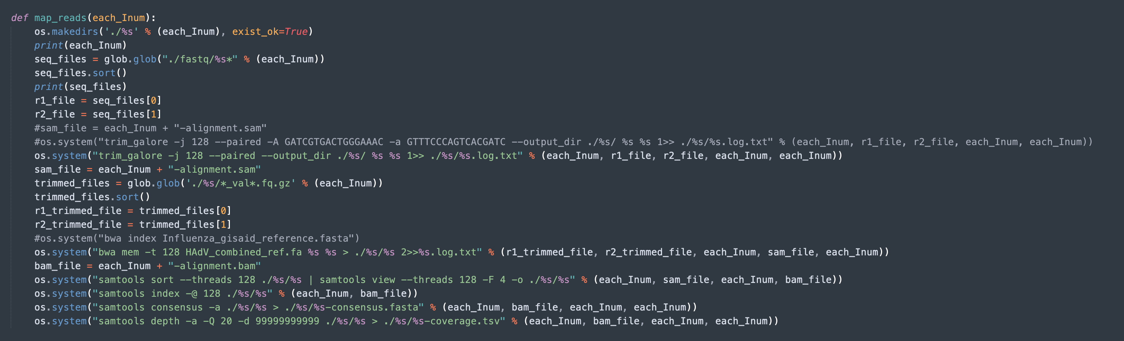
NGS workflow update proposition: Secondary analysis
Suggested updates:
Code
Splitting the function into smaller, more specific functions. i.e. Differentiating between bioinformatics tools and pre-processing.
Formatting
Improve readability by using f string formatting (python 3.6+, current gold standard) instead of % string formatting for string concatenation.

Slide 7
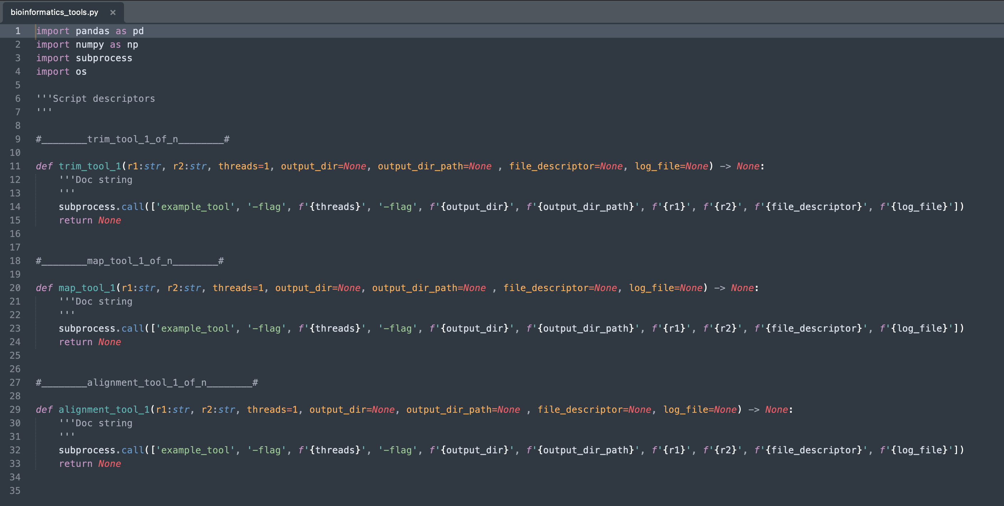
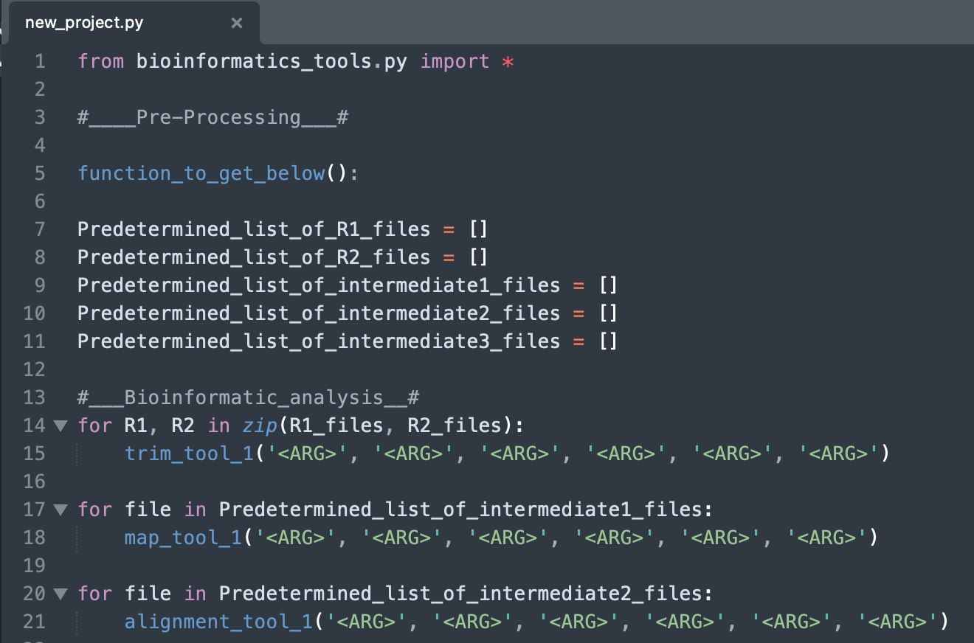
Secondary analysis: ¹All the bioinformatics tools used for secondary analysis will be coded as functions within a single master script.
1
2
1
The bioinformatics_tool.py screenshot displays pseudocode template of the master bioinformatics tool script.
The functions with the tool script can be imported into any new_project.py script via syntax “from <import_target_script.py> import <name_of_function> or <*> to import all functions.
2

Slide 8
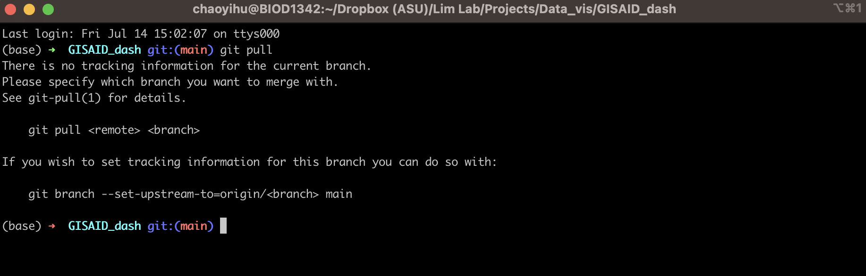
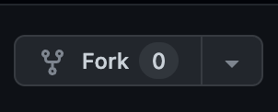

Secondary analysis: ²This scrip will be maintained and updated in a repository on Github
Lab members will have access to the latest version of the bioinformatics_tool.py script via Git/Github interactions.

Slide 9
To dos
Primary Analysis
Directory structure, organization and file transfer.
¹Function for generating directory structure
Use existing structure
²Function for moving .gz files to working directory
³Function triggering workflow
Incorporate existing method
⁴Function for slack post
Use existing method
1
Pluto
2
Incorporate cassettes.
⁵Function to read in input file with parameters
⁶Functions for bioinformatics tools
These would make up the bioinformatics_tools.py script
Secondary Analysis
3
Project
Automatically generate standard forms of analysis.
⁷Function for Taxonomy/phylogeny analysis
⁸Function for variant calling analysis.

Slide 10
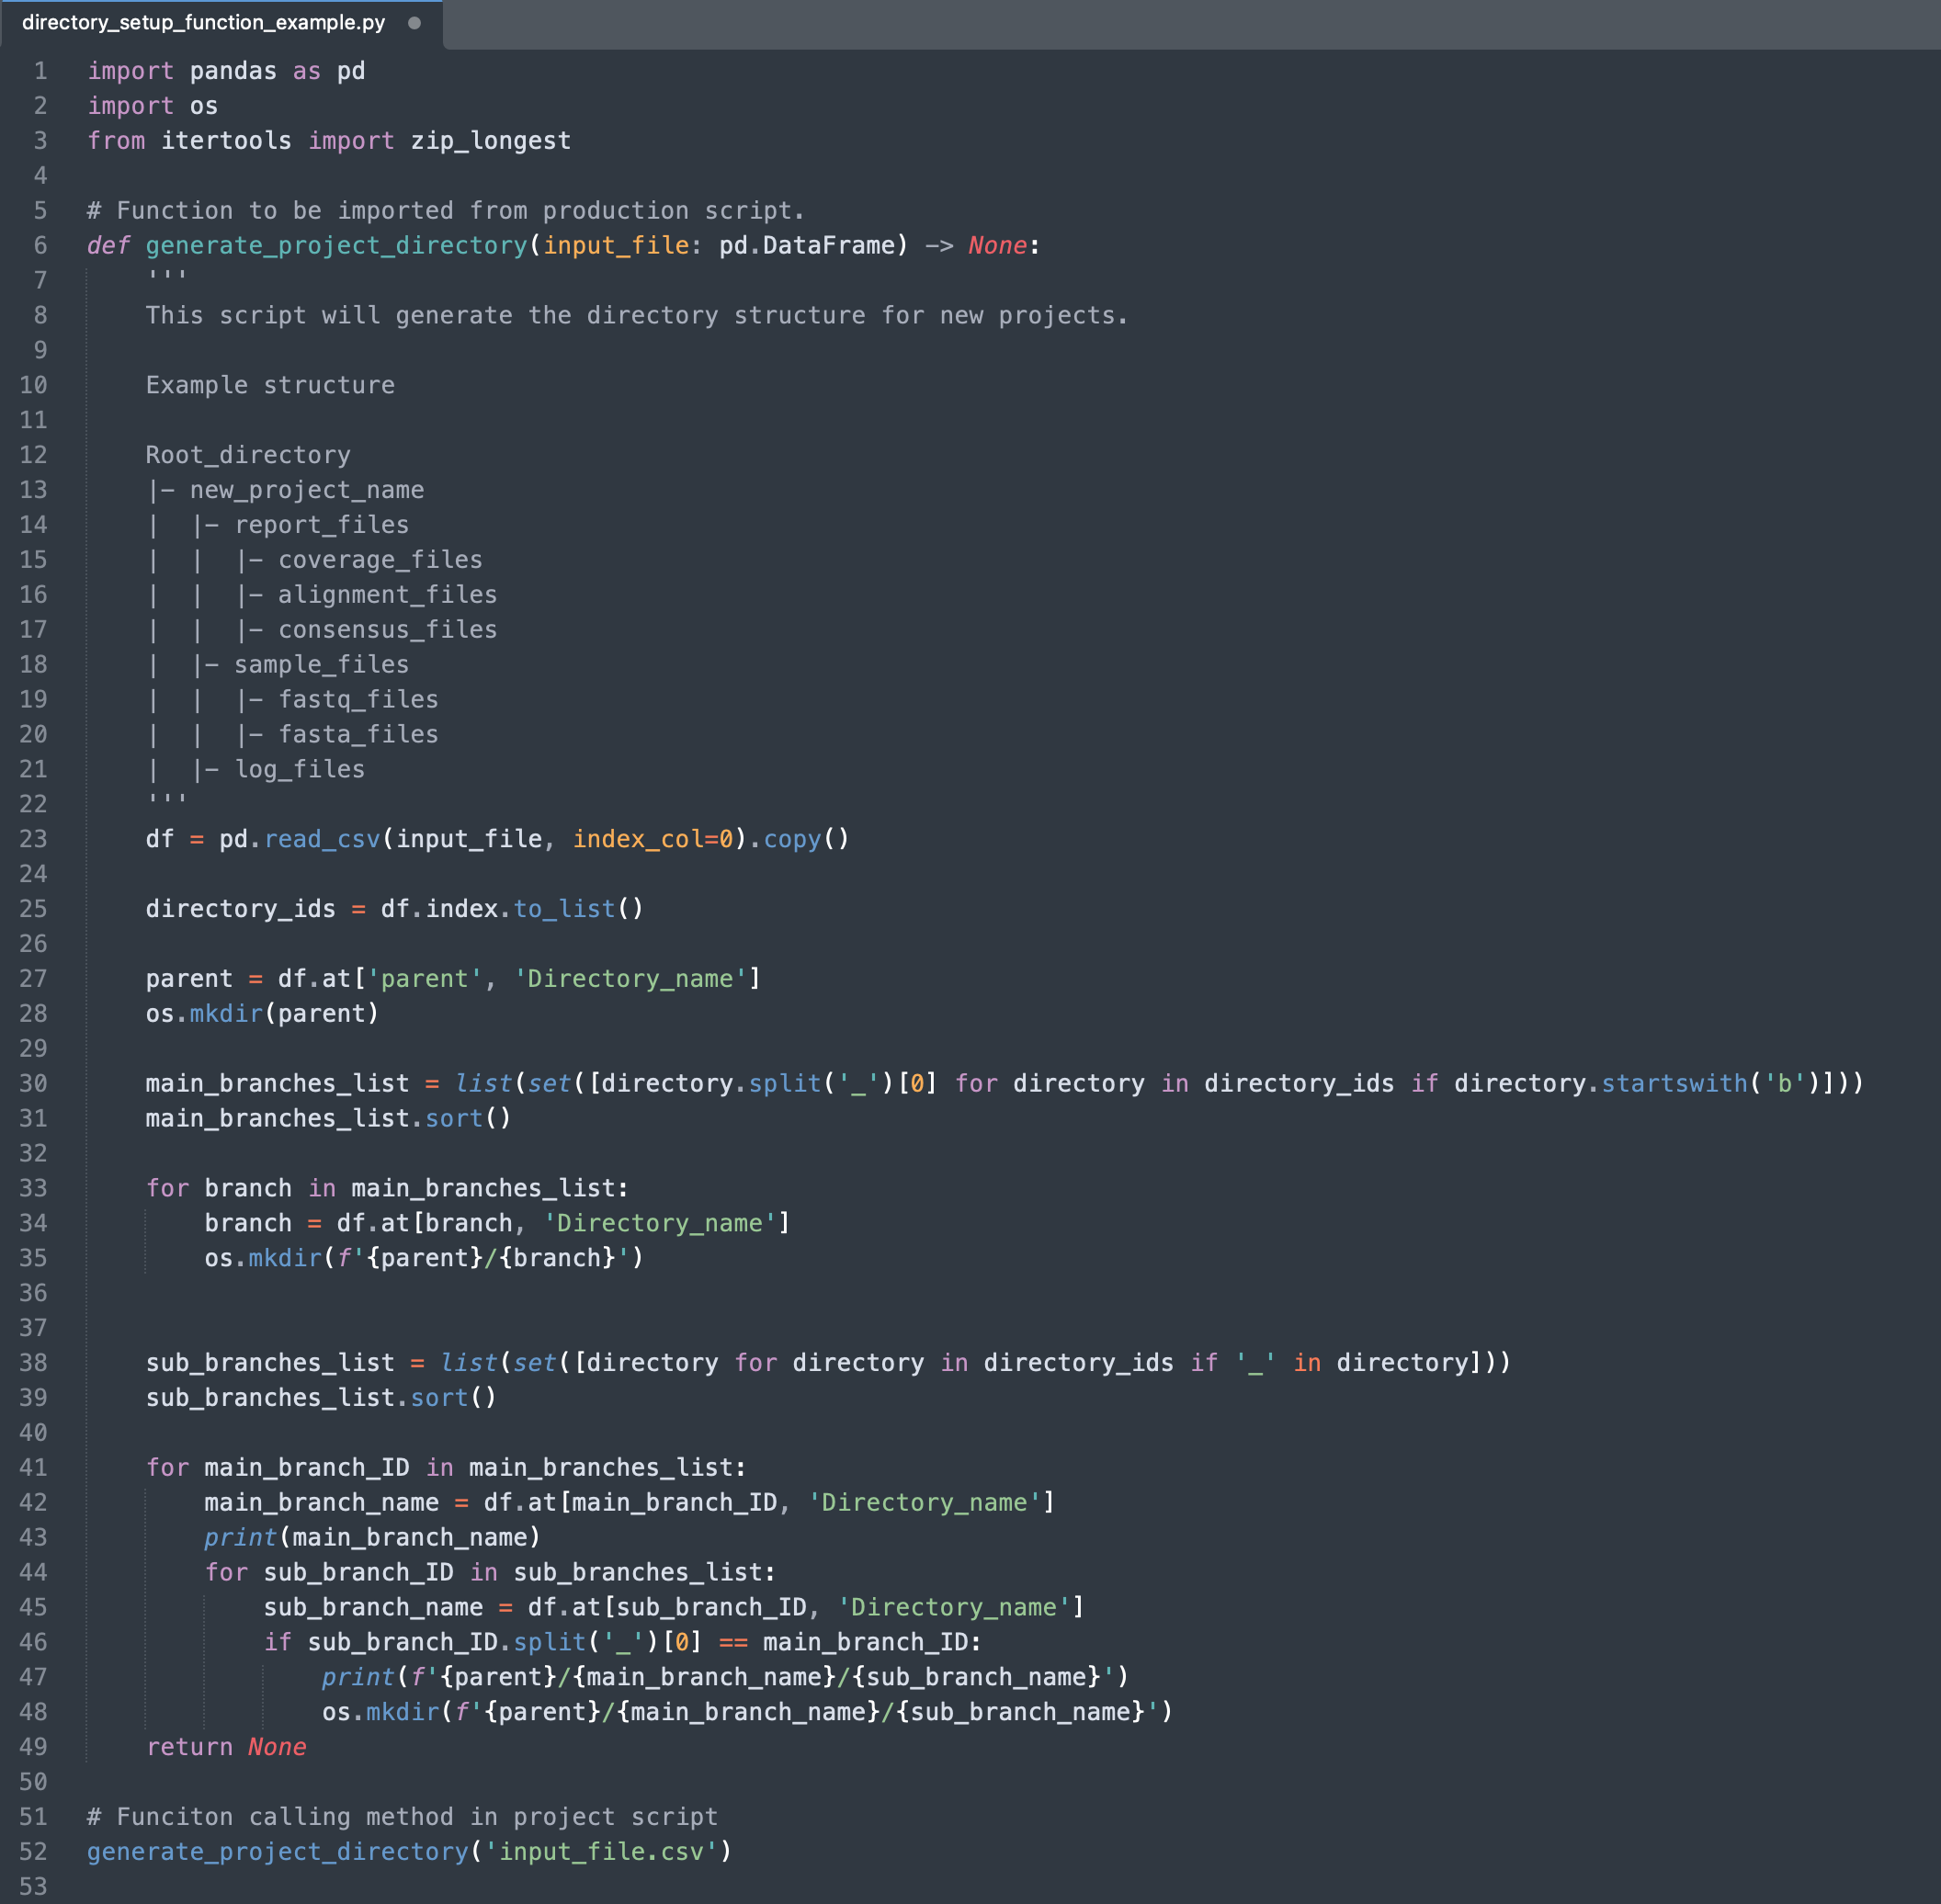
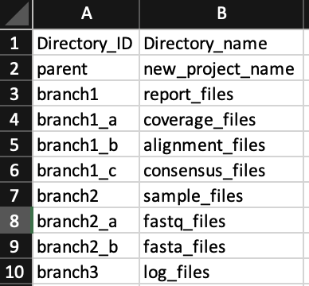
Code Example: Function 1
Input File
Takes input file and generates directory structure based on Directory_ID and Directory_name columns.
Directory_ID format must follow the above. Directory_name can be anything.
There should only be 1 parent directory.
Function is currently only coded to accommodate branch with 1 sub-branch layer.
Case sensitive, uses “_” instead of white space

Slide 11
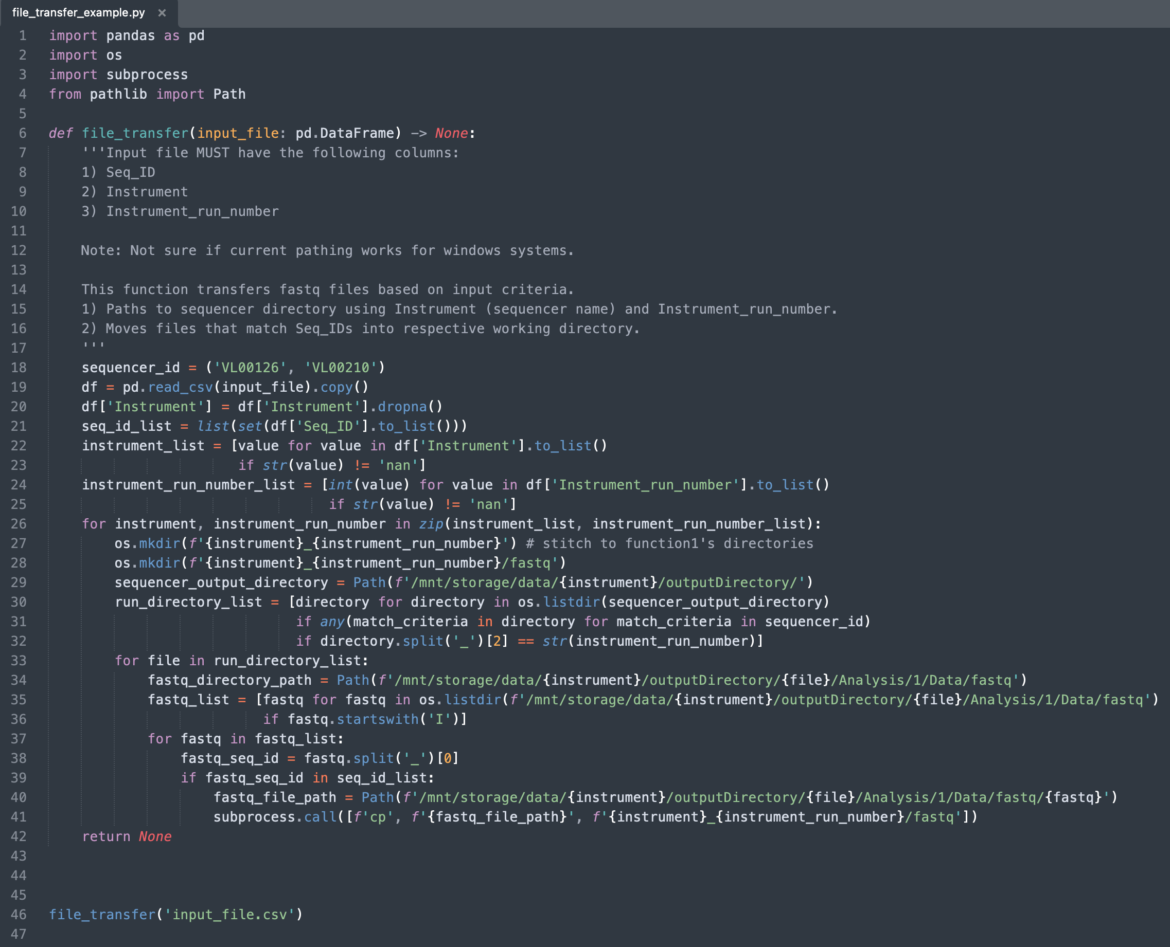
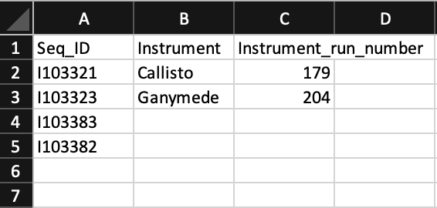
Code Example: Function 2
Input File
Takes input file - locates sequencer directory/fastq files.
Moves files based on directory structure generated in function1.

Slide 12
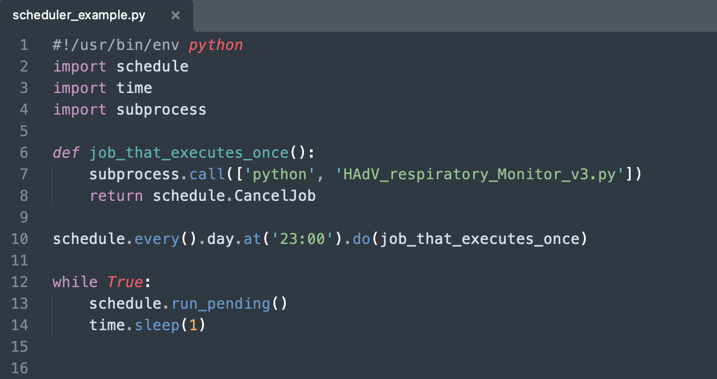
Code Example: Function 3
Automating the workflow
Simple workflow scheduling function using Python ‘schedule’ library

Slide 13
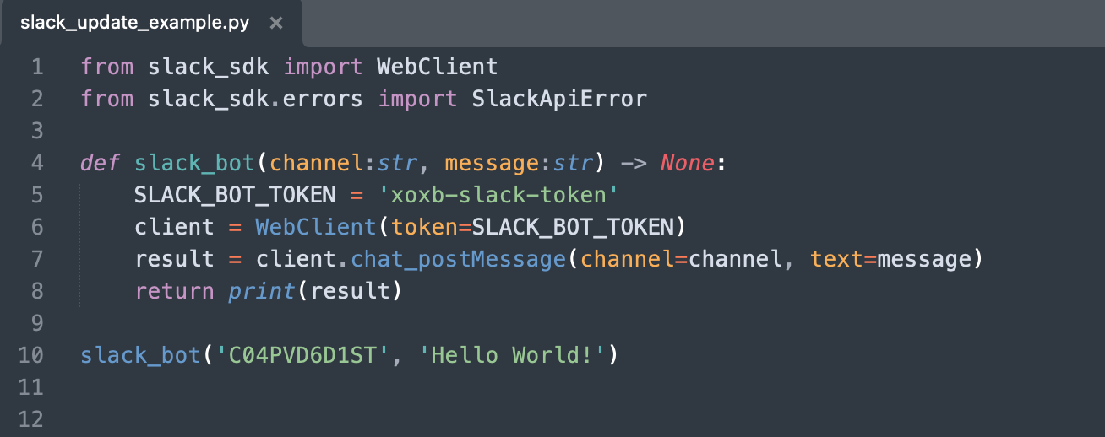
Code Example: Function 4
Same-same, but different.

Slide 14
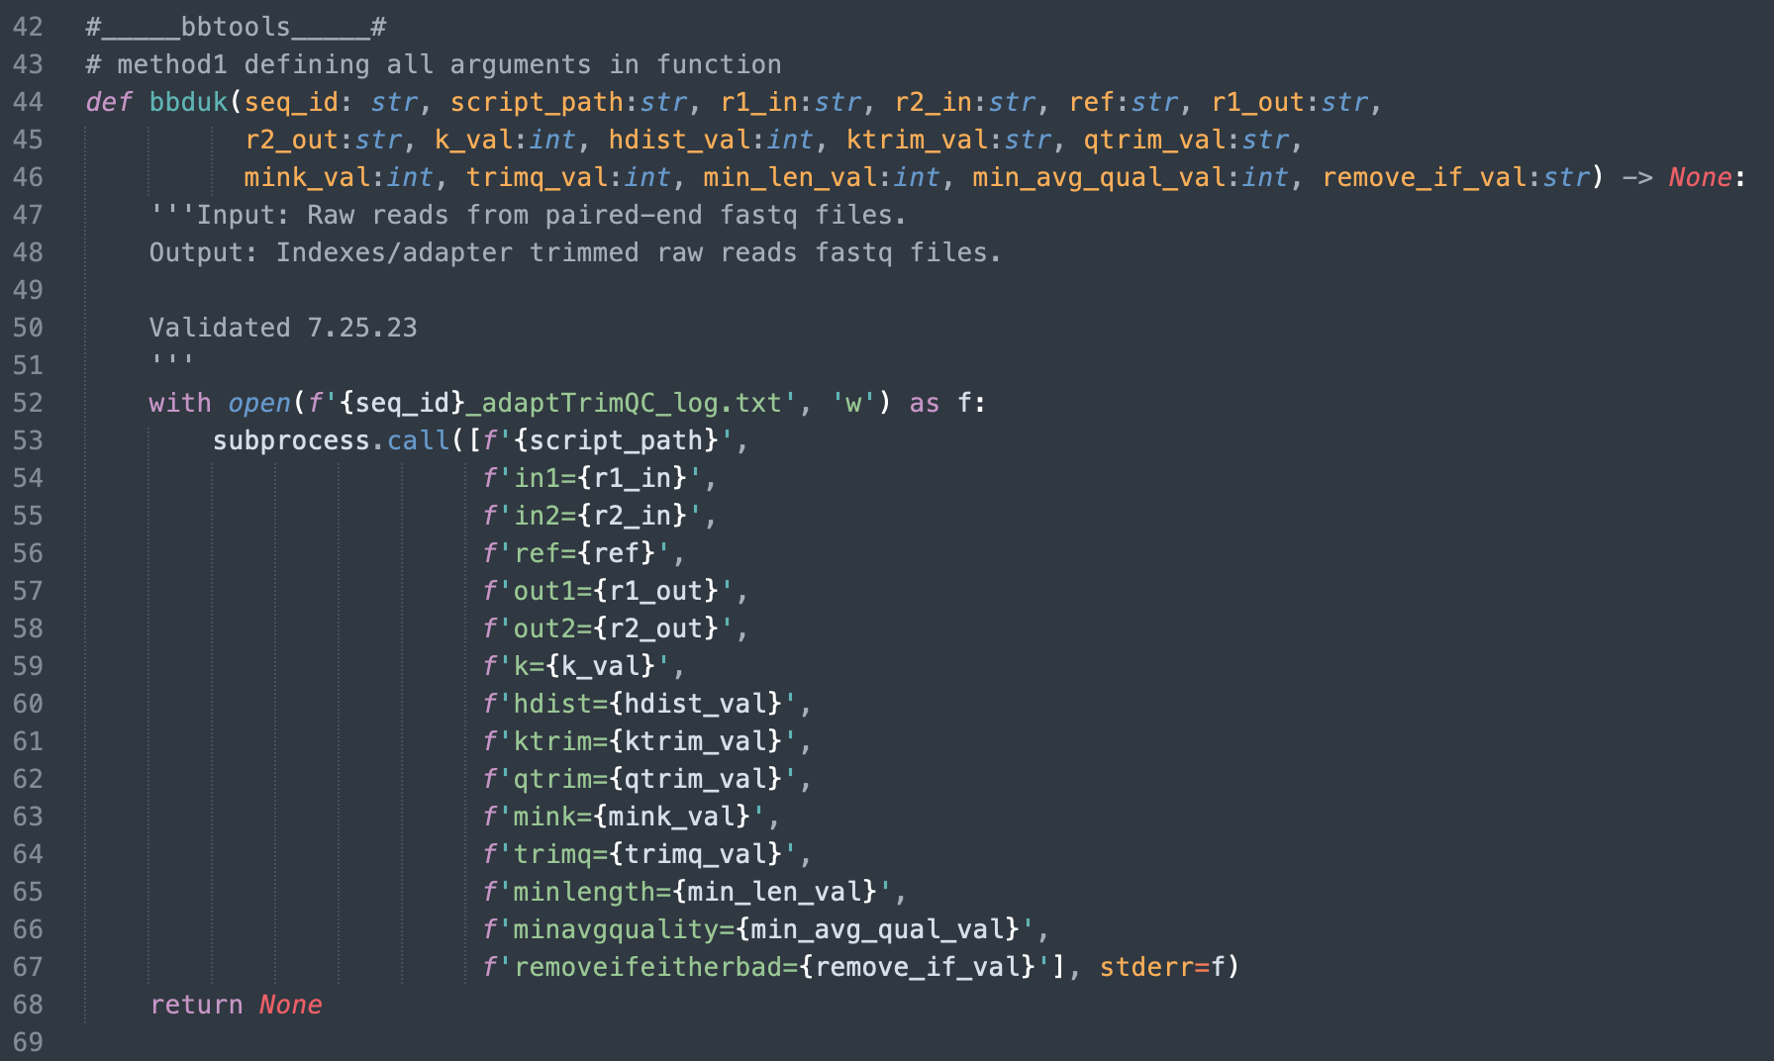
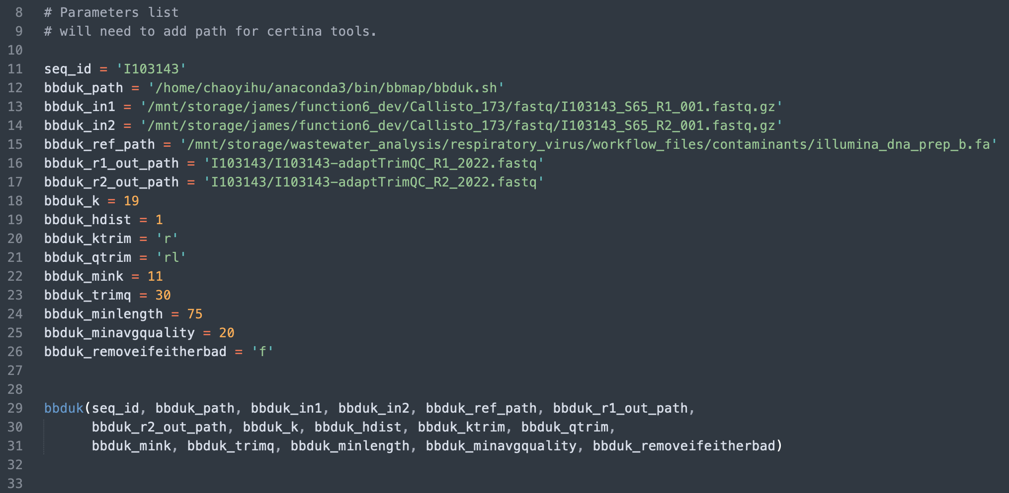
Code Example: Function 5a
1
Two different input methods
Method_1: Explicitly defined input arguments for Command Line Interface (CLI) tools
Pros:
Works well with input files
Cons:
Rigid
Ideal use case:
Automation of established pipeline

Slide 15
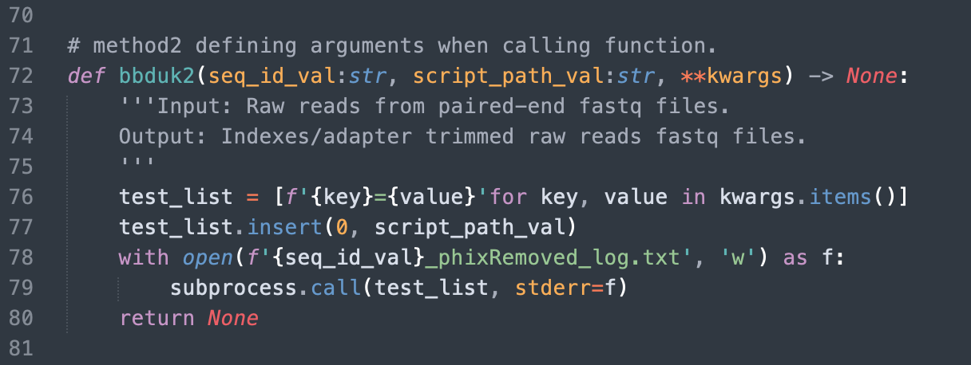
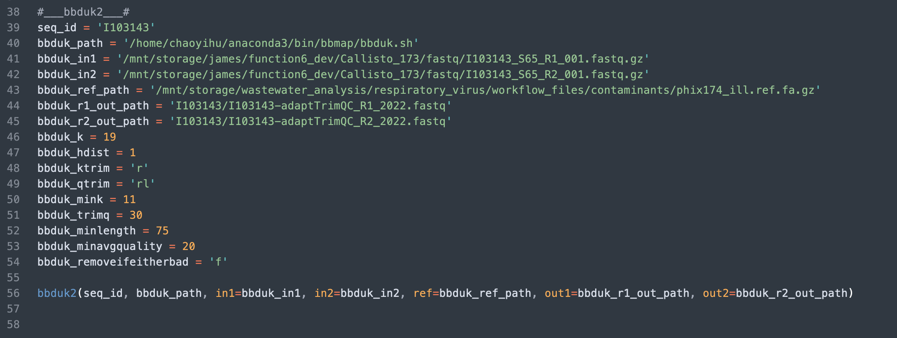
Code Example: Function 5b
2
Two different input methods
Method_2: Defining input arguments when calling function.
Pros:
Versatile
Cons:
Does not work well with input files.
Ideal use case:
Pipeline development eg. QC tuning

Slide 16
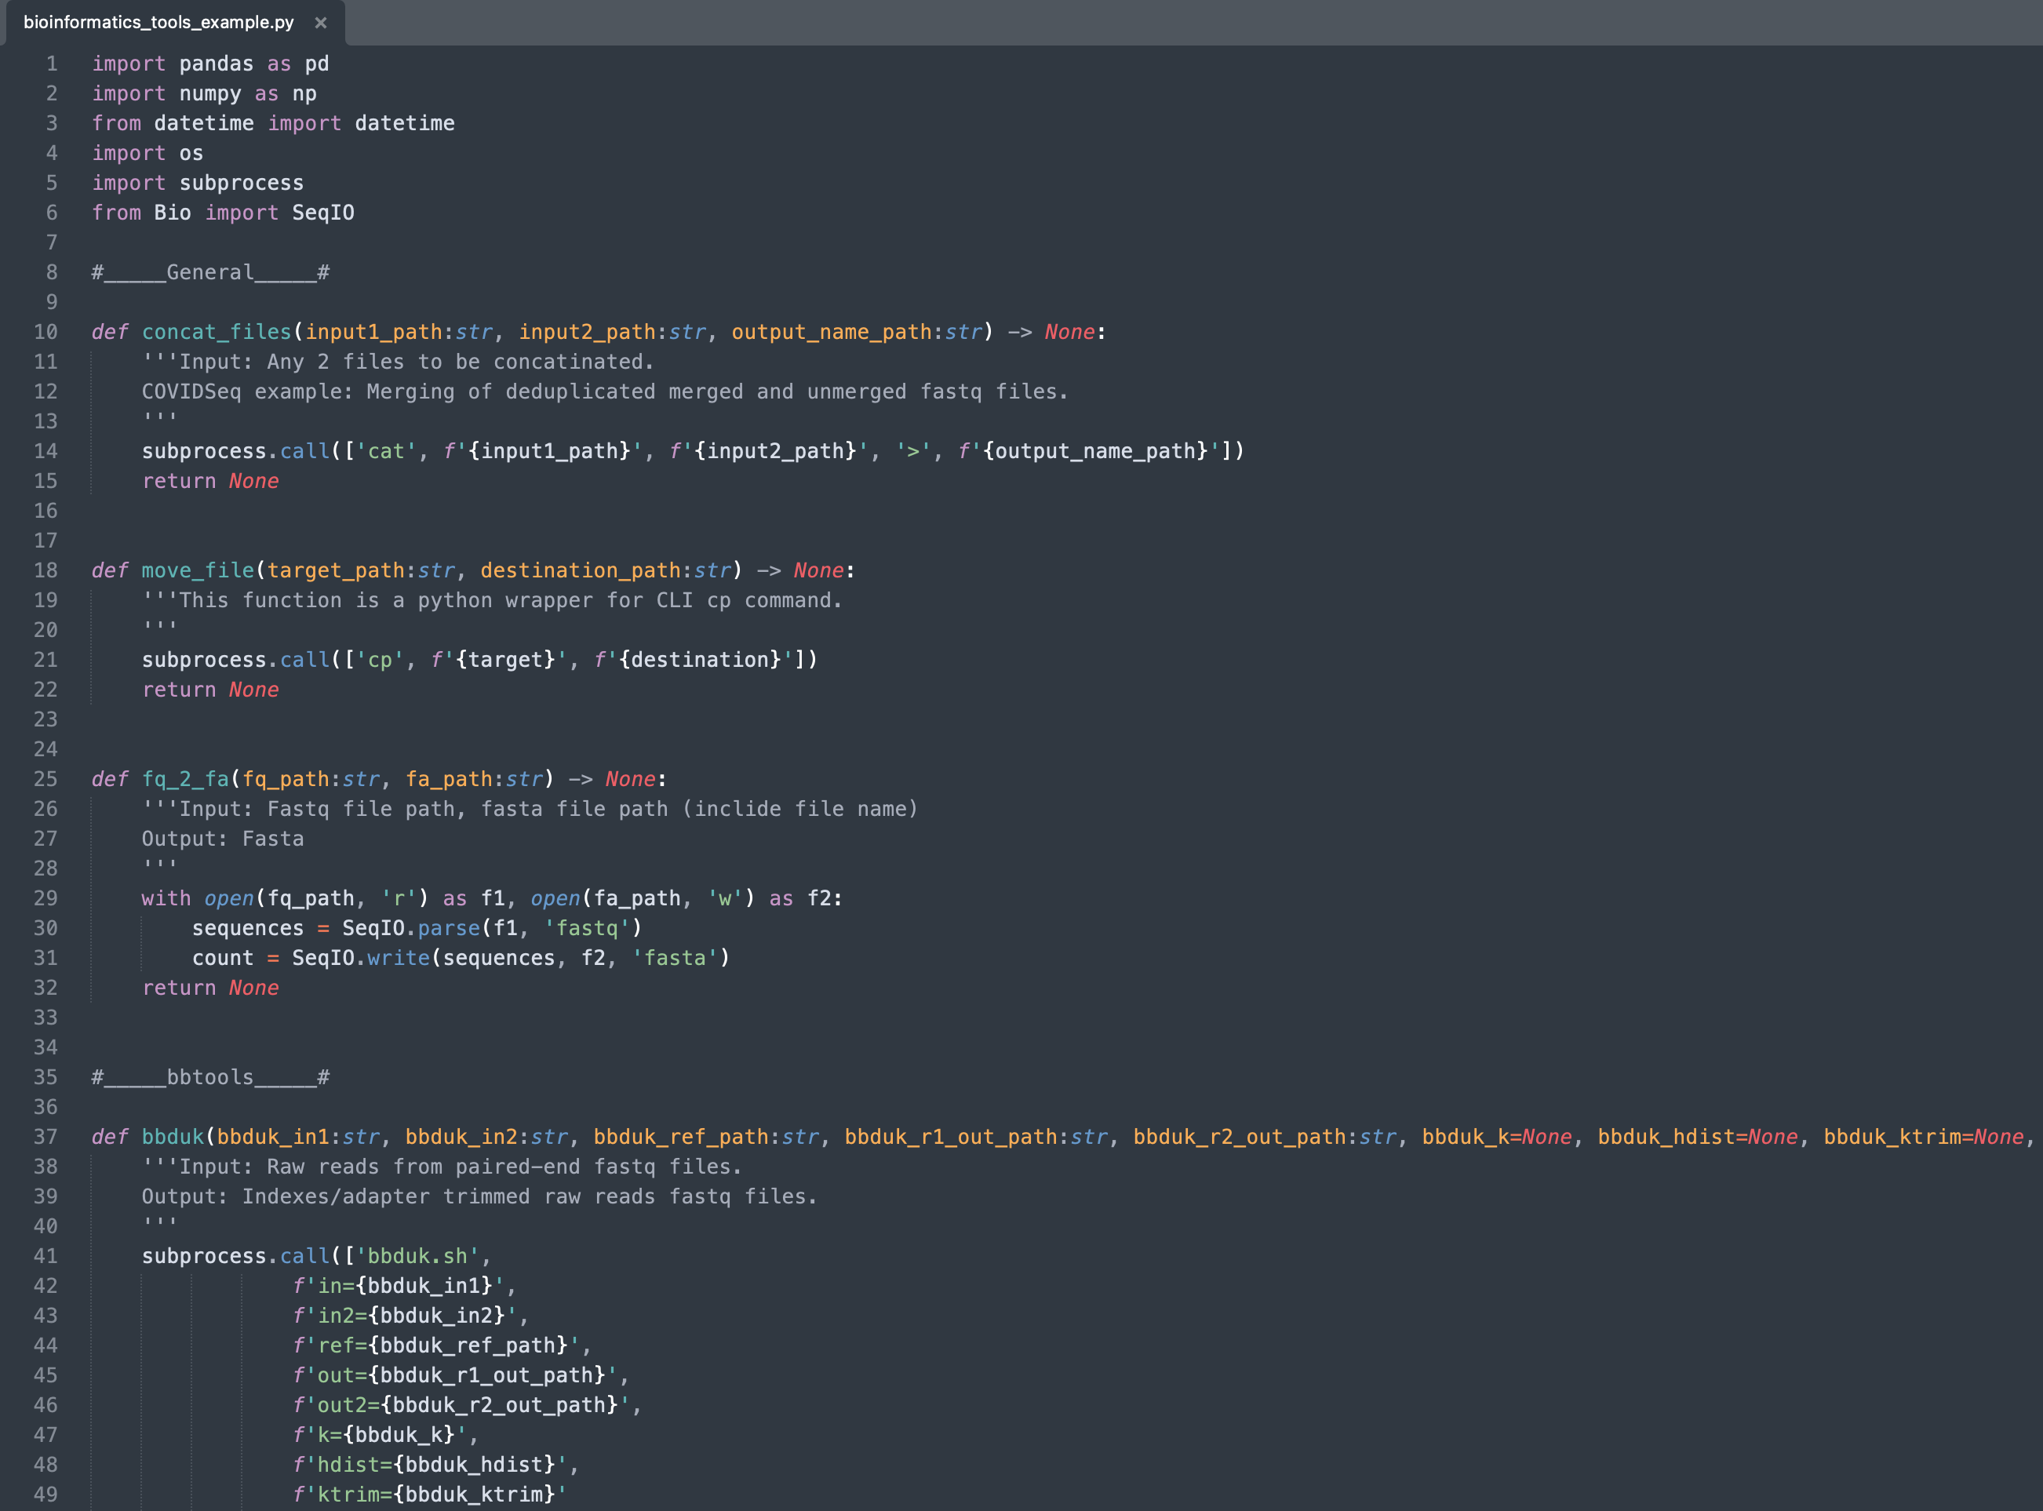
Code Example: Function 6a
Bioinformatics tools
Functions separated categorically
Each function should perform relatively specific task
Utilizing “Don’t Repeat Yourself” (DRY) coding principle
Scripts should be written using updated syntax corresponding to the latest version of PEP8
Functions should include doc strings and type hints.
Functions in the General category perform general purpose operations.
Include python wrappers for Linux commands, data wrangling/cleaning, and auxiliary tasks.
Functions in other categories are essentially python wrappers for CLI tools. While redundant, this method would be considered more “pythonic” and easier to integrate into other python scripts.

Slide 17
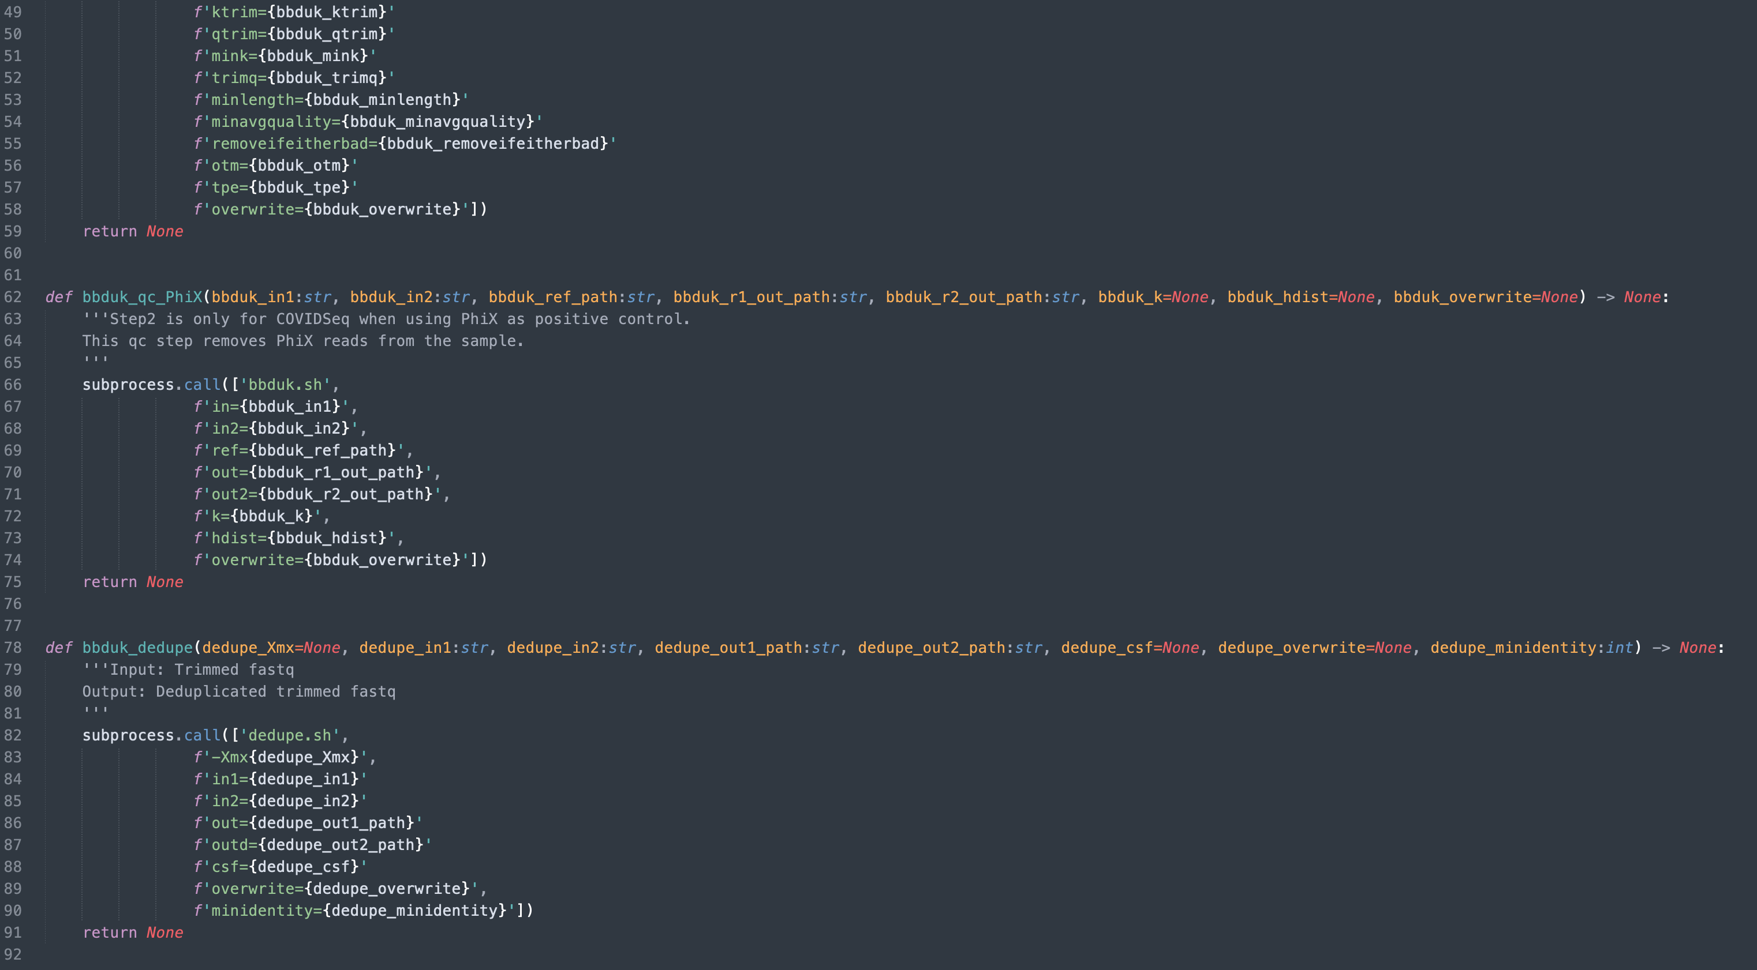
Code Example: Function 6b
Example COVIDSeq workflow
Secondary analysis
1) QC1: Trim adapters/index sequence
2) QC2 : Remove PhiX reads
3) Deduplication of forward (R1)/ Reverse (R2) files
4) Merging overlapping reads in R1/R2 files 5) Concat reads from merged and unmerged files
6) Deduplication of concatenated file
Downstream project specific analysis
7) Converting fastq to fasta
8) Mapping reads using bowtie2
9) Read selection/sorting using samtools view/sort
10) Indexing mapped reads using samtools index
11) Generate alignment summary statistics reports
12) Moving files to end destination

Slide 18
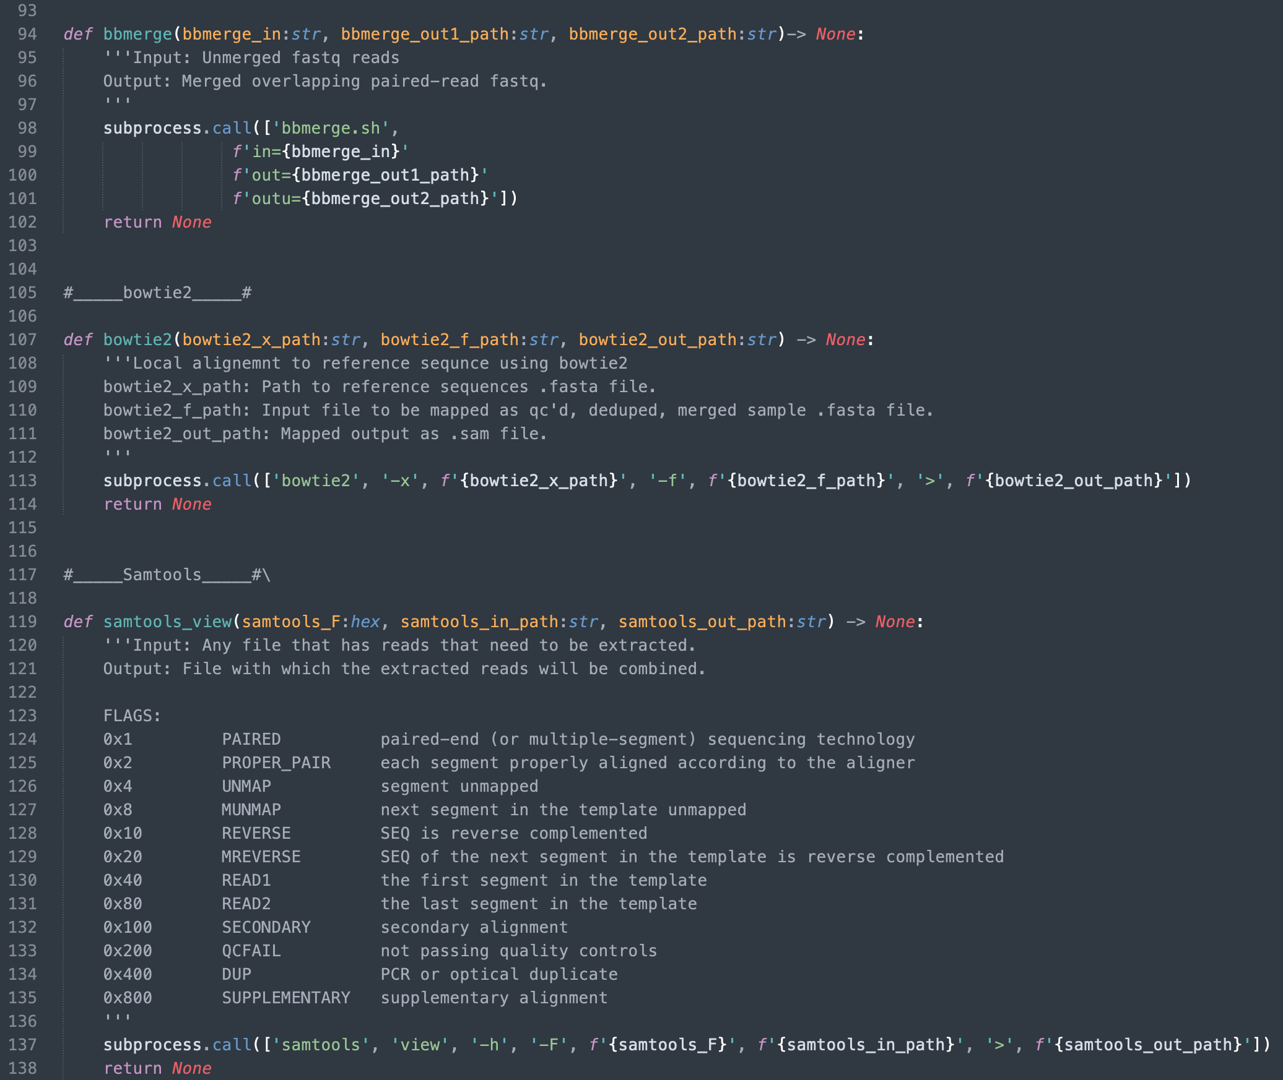
Code Example: Function 6c

Slide 19
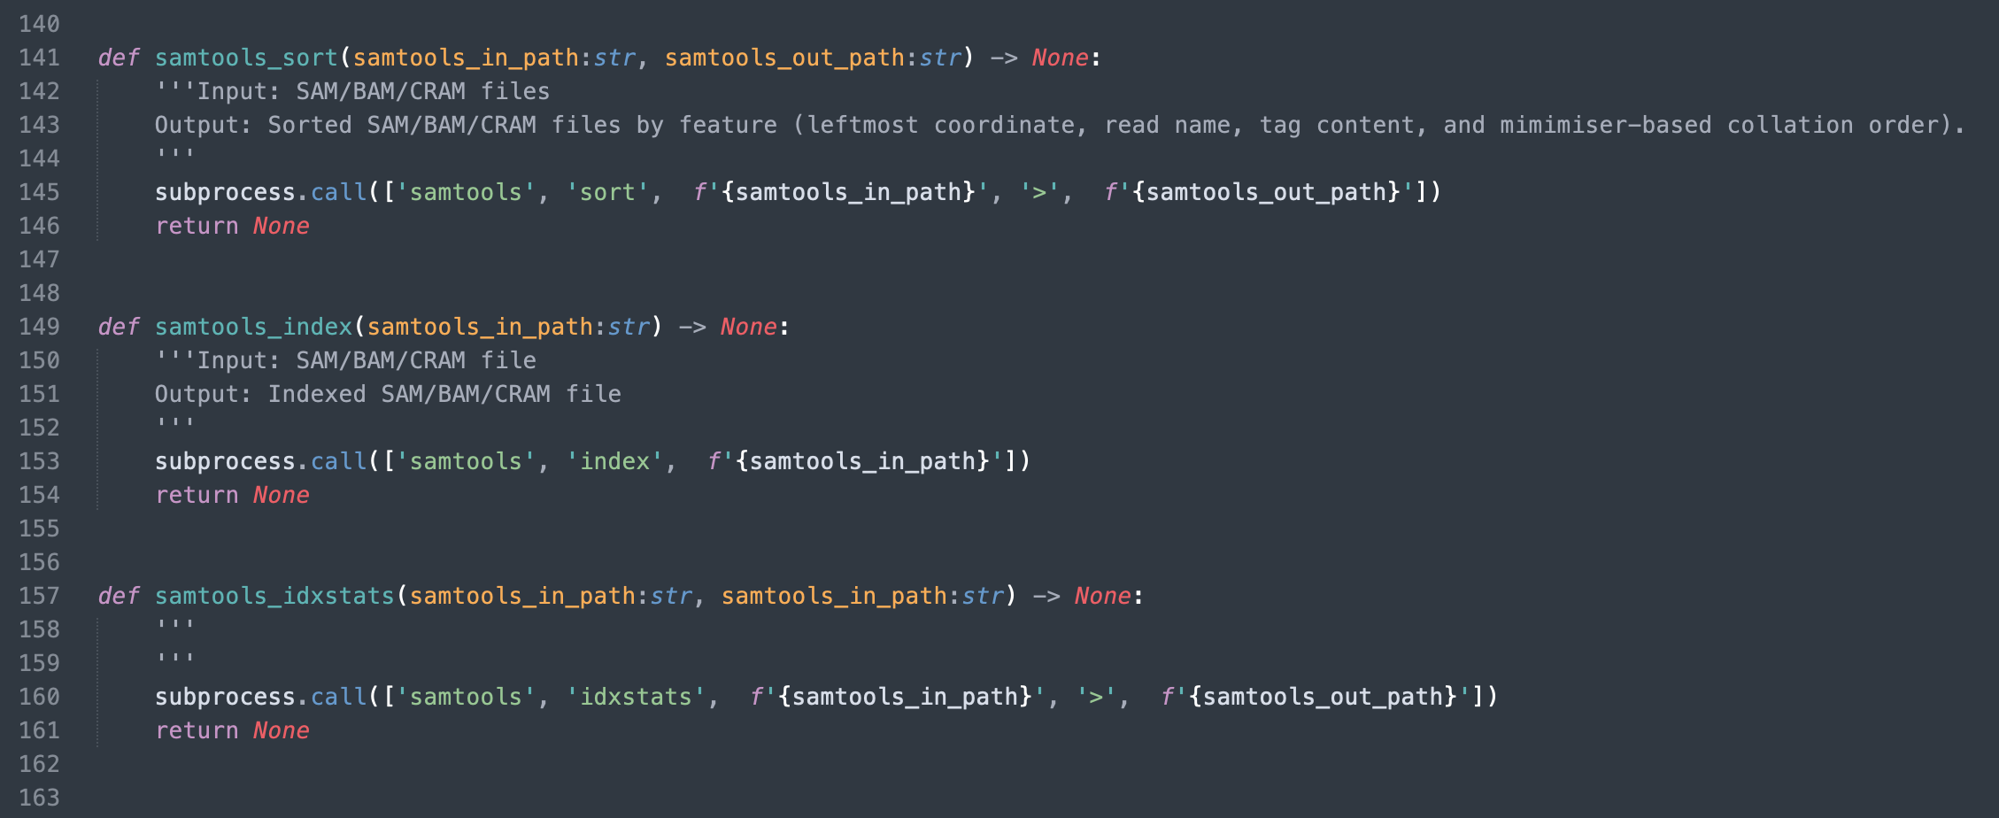
Code Example: Function 6d

Slide 20
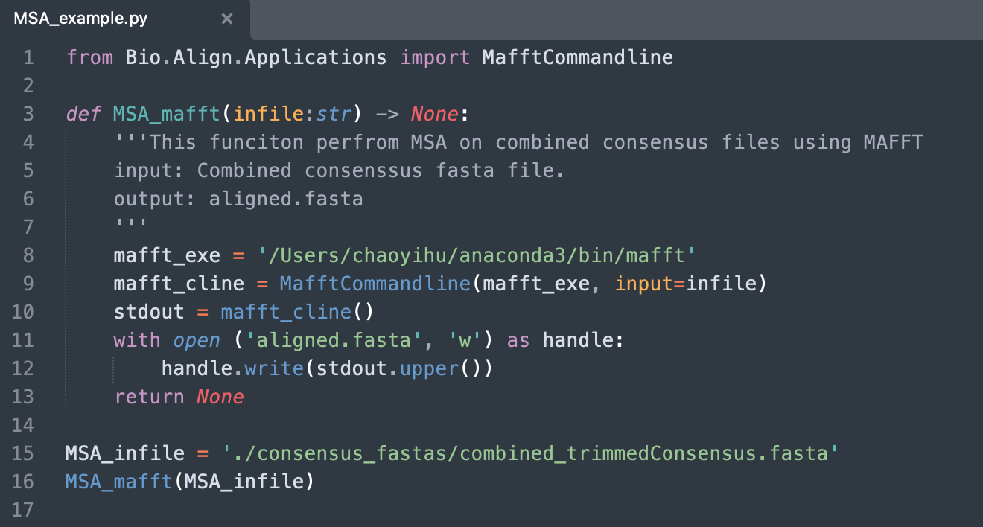
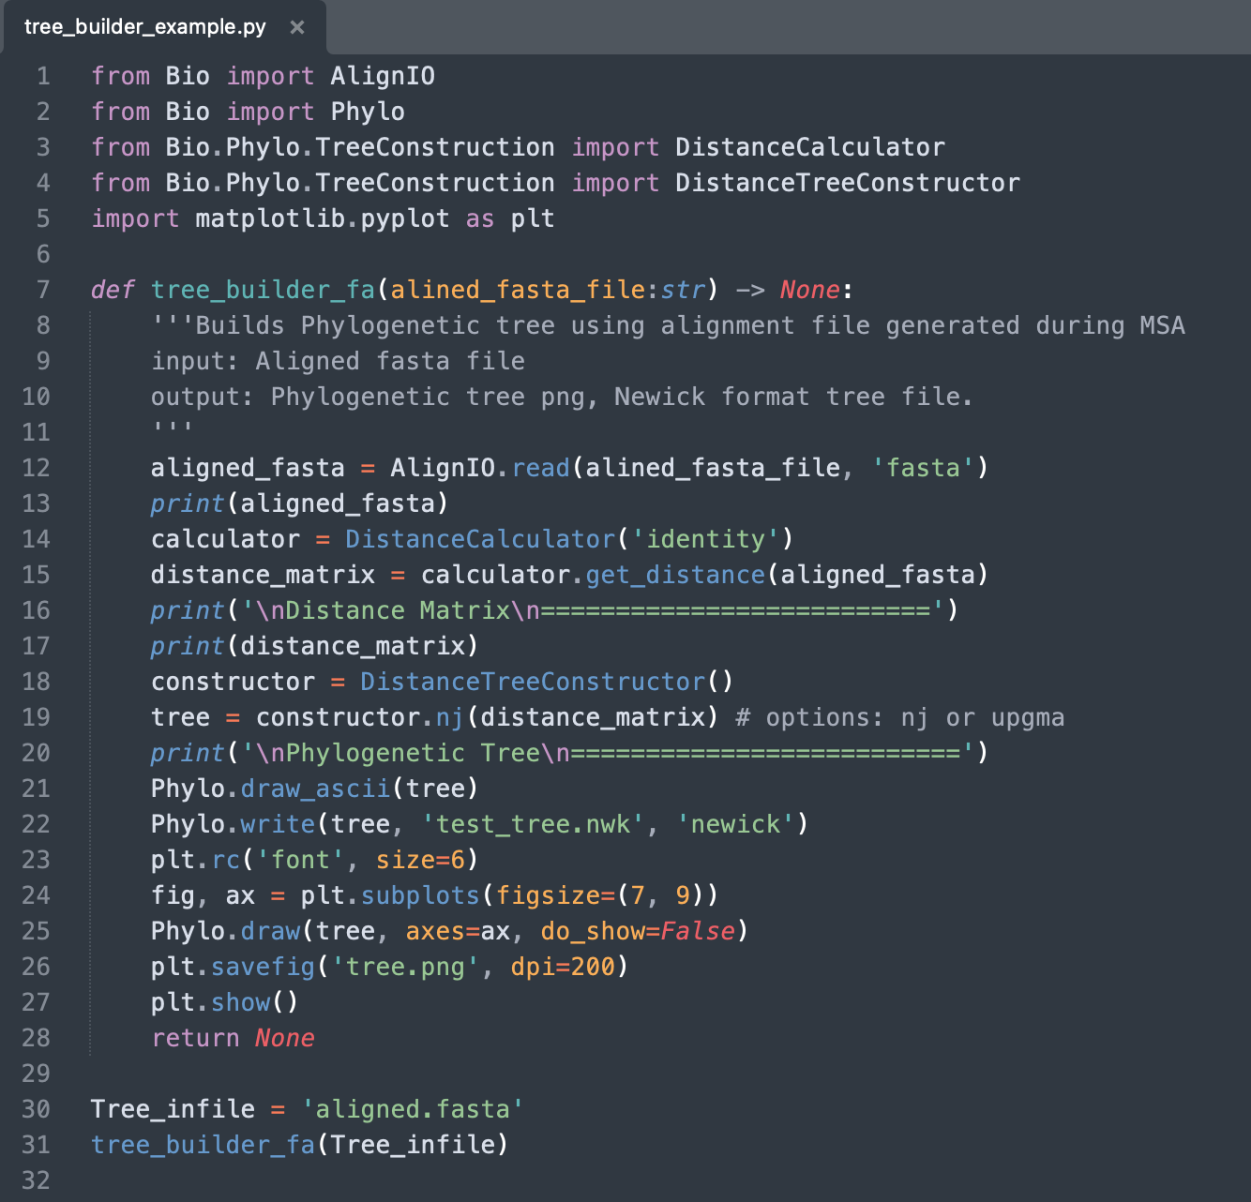
Code Example: Function 7
Tree building using distance matrix method
Distance matrix method uses Multiple Sequence Alignment (MSA) files as inputs to build trees.
Combined consensus files aligned using MSA algorithm.
Progressive
ClustralW,
Clustral Omega
Iterative
MUSCLE,
MAFFT
Template
BLAST
PSI-BLAST
MSA output (aligned file) is fed into scrip. Distance matrix is calculated using specified model, and the tree is generated along with a Newick format tree file.

Slide 21
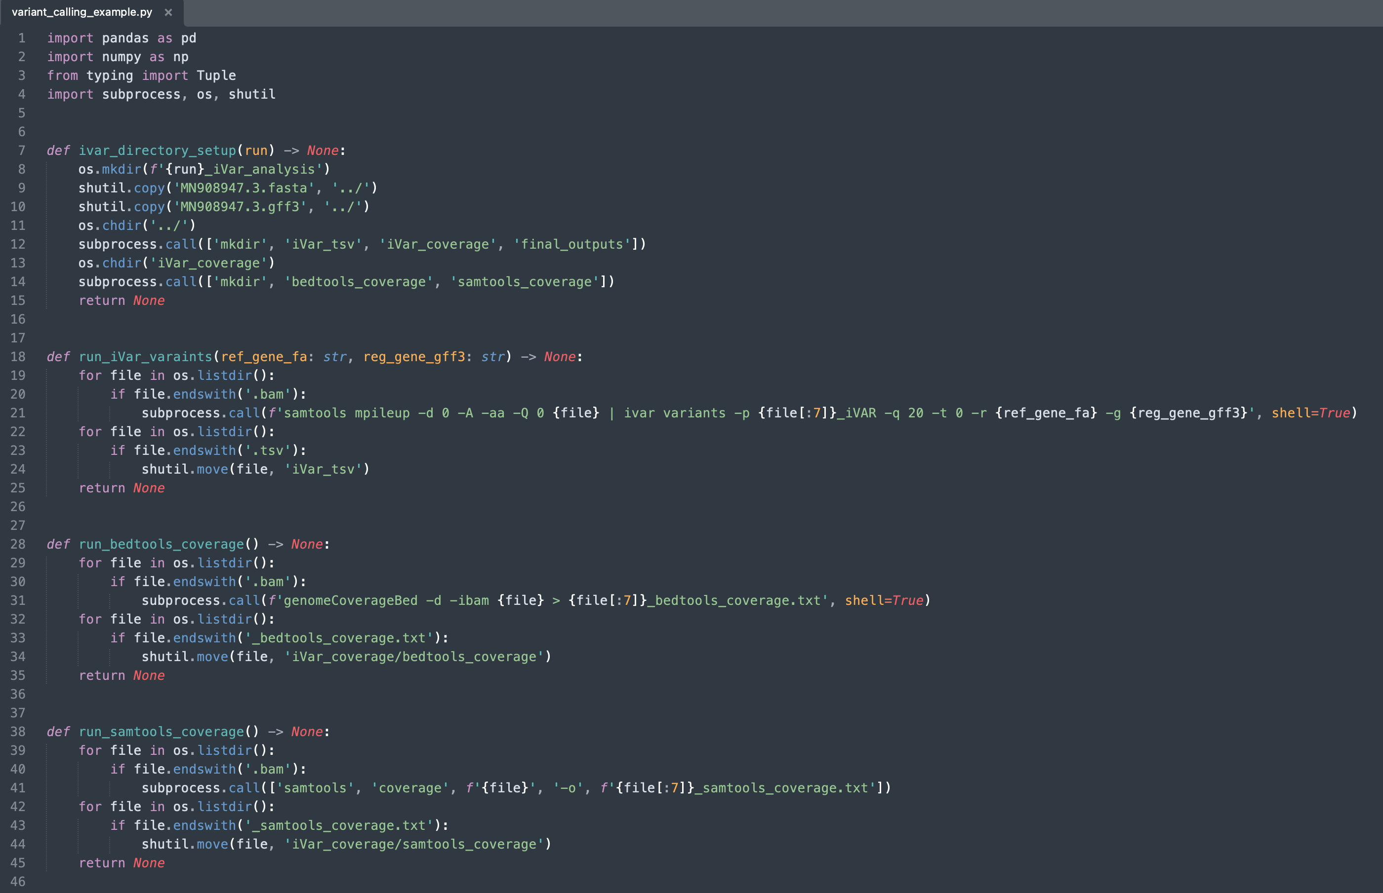
Code Example: Function 8a

Slide 22
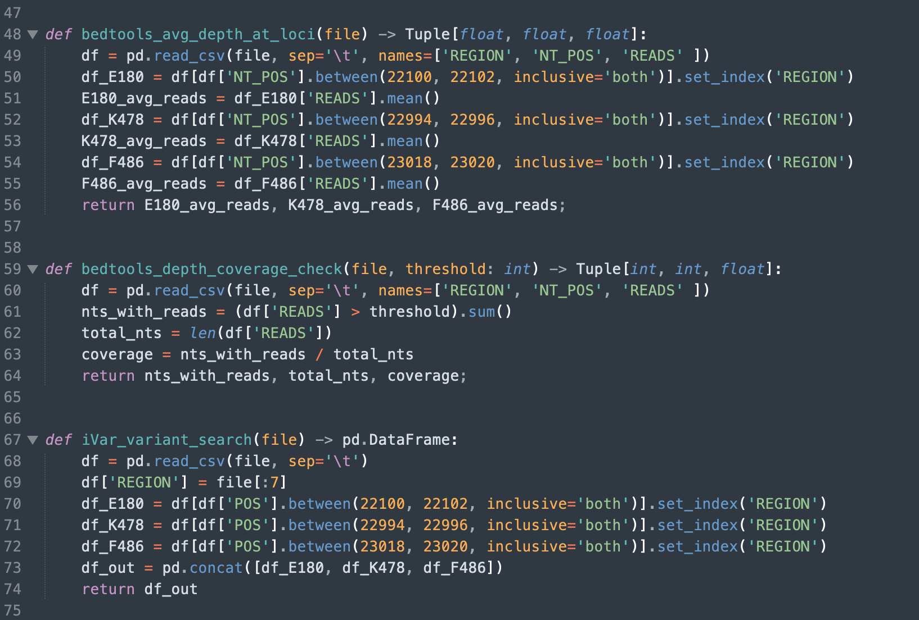
Code Example: Function 8b

